Slide 1
Divide and Conquer
What’s divide-and-conquer
How to analyze a divide-and-conquer algorithm
An example: binary search

Slide 2
What is divide and conquer
A technique for designing algorithms that decompose instance into smaller sub-instance of the same problem
  Solving the sub-instances independently
  Combining the sub-solutions to obtain the solution of the original instance

Slide 3
A general template
DC(x)
{
if (x is sufficiently small or simple)
adhoc(x); // use a basic sub-algorithm
decompose x into small instances x[0],..,x[l-1]; // divide
for (i=0; i<l; i++) //conquer
s[i] = DC(x[i]);
combine s[0],.., s[l-1] to obtain solution s for x; // combine
return s;
}
Three conditions to be considered
  When to use the basic sub-algorithm
  Efficient decomposition and recombination
  The sub-instances must be roughly the same size

Slide 4
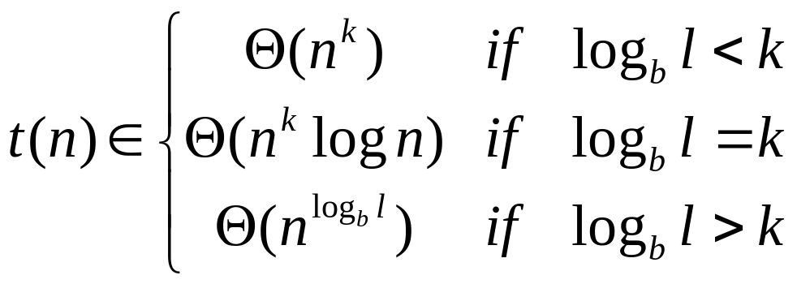
Running-time analysis
Assume that the l sub-instances have roughly the same size n/b for some constant b
Let g(n) be the time required by DC for dividing and combining on instances of size n,
  g(n) is the total time excluding the times need for the recursive calls.
  We have t(n) = l·t(n/b) + g(n)
If g(n)  Θ(n^{k}) for an integer k, we have

Slide 5
Sequential Search from a sorted sequence
T[] is a sequence in nondecreasing order
Return the insertion position of a new value x
sequentialSearch(T[], x)
{
for (i=0; i<n; i++) {
if (T[i] >= x) // T[i-1]<x<=T[i]
return i;
}
}
Cost: best, worst, average?

Slide 6
Binary Search
binarySearch(T[], x)
{
if (n==0 || x>T[n])
return n;
else
return binaryRecursive(T, 1, n, x);
}
binaryRecursive(T[], i, j, x)
{
// we know T[i-1] < x <= T[j]
// assume T[-1] is sufficiently small
if (i==j)
return i;
k = (i+j)/2;
if (x <= T[k])
return binaryRecursive(T, i, k, x);
else
return binaryRecursive(T, k+1, j, x);
}
Cost?

Slide 7
Cost of binary search
T(n) = T(n/2) + Θ(1)
T(n)  Θ(lg n)

Slide 8
Binary Search (iterative)
int binarySearch(int A[], int n, int x)
{
int i, j, k;
i=1; j=n;
while (i<j) {
k = (i+j)/2;
if (x<=A[k]) j=k;
else i = k+1;
}
return i;
}

